Slide 1


HR & Finance Operations Transformed
aFinPROs

Slide 2
About us
aFinPROs is a software enabled service (SeS) model offering that manages complete end-to-end HR and Finance operations to companies of all sizes.
aFinPROs become your virtual HR and Finance operations Team. All these operations are done on an enterprise class integrated software where you will have access to all your data supported by expert team at back-end.

Slide 3
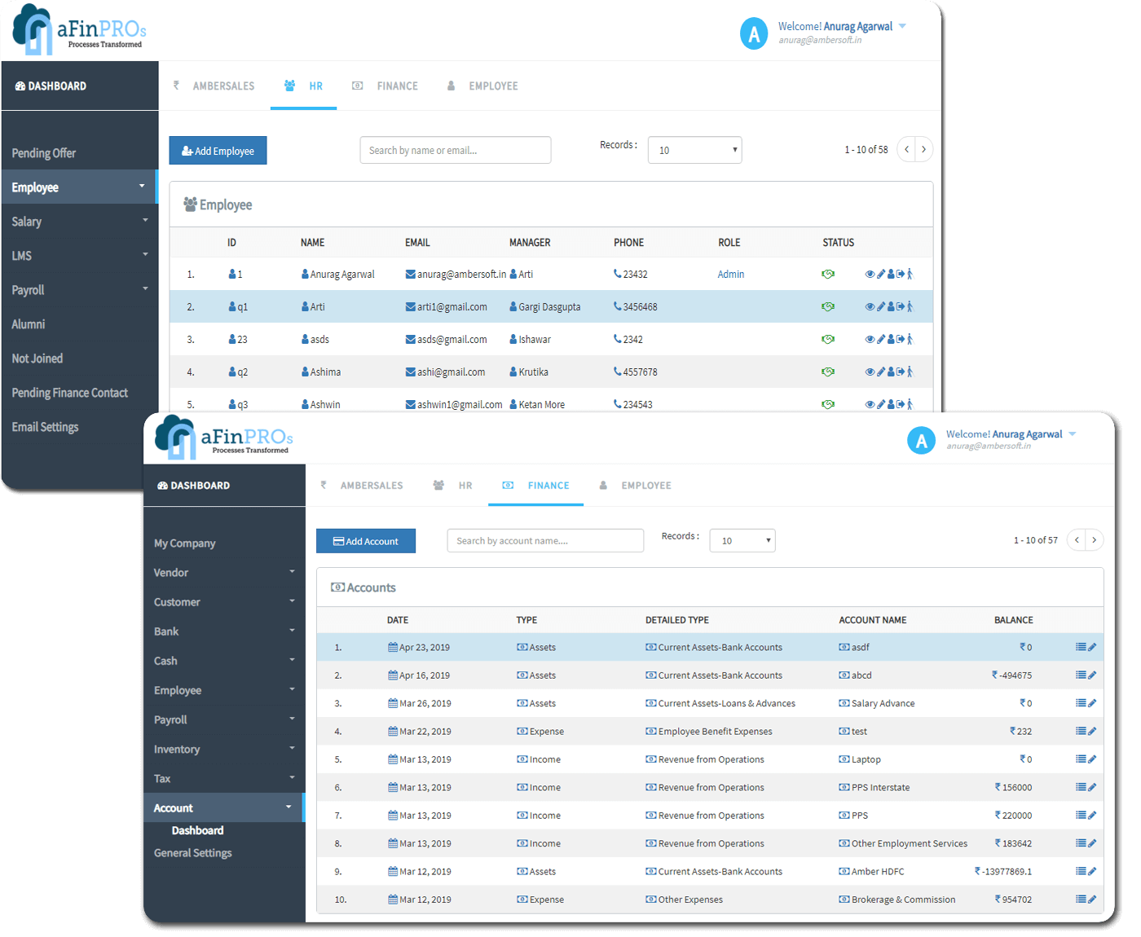
Real-Time Screenshots of aFinPROs
aFinPROs brings your customers, vendors, and employees on a single platform where you can manage transactions with them anywhere anytime.
aFinPROs makes accounting, finance, and HR a completely integrated business function.

Slide 4

Our Founder
Our founder Mr. Anurag Agarwal, a technologist and entrepreneur by professional has worked for more than 20 years in software industry with large MNCs like Symentac. He has been an entrepreneur for 10+ years; currently heading 6 other companies. He founded aFinPROs with a simple goal of easing HR and Finance operations of SMEs

Slide 5

We give software enabled offerings as
HR
Offerings
+
Finance Offerings
Integrated Support Team at back-end

Slide 6
Offer management to new employee
Employee on-boarding
Employee directory
Employee life cycle from offer to exit
Salary structuring
Leave Management
Expense Management
Employee loan
Salary TDS
PF
PT
ESIC
Payroll
HR
Offerings

Slide 7
Purchase order generation
Invoice generation as well as booking
Payments
Cash management
Bank statement
GST
TDS
Book-keeping
Auto payment reminders
Work with your customers for payment followup
Vendor payments
Finance Offerings

Slide 8
aFinPROs solution is an enterprise grade ERP solution with integrated software + services priced nominally at
Rs. 4999*/- month
(for 10 employees)
Product Pricing

Slide 9
Comparing current cost of operations with
aFinPROs services Cost
*Given cost is of a typical company size of 10 employee*
*Values are in Thousands*

Slide 10


Testimonials

Slide 11





Some of our leading clients

Slide 12
Nikhil Patil (BDM)
+91 7447750172
nikhil@afinpros.com
Office addr:- 4th Floor, Business Square, opp. Regent Plaza, Baner-Pashan Link Road, Pune
Visit our website: www.afinpros.com
Contact us

